Slide 1


Slide 2

#LifeKoKaroLift
SGC Coaching:
Articulate your Journey | Activate Students’ Vigour| Accelerate Mutual Growth
Session 5
Inferential Statistics

Slide 3
Agenda
Quick Recap –(10 mins)
Last 2 weeks
Focused Teaching –(50 mins)
Inference Statistics through business cases
Doubt resolution –(30 mins)
Explain using demonstration and exercises

Slide 4
Recap: What the learner have learnt in the week
Sampling
Probability distributions
Hypothesis Formation
Null vs. Alternate
Drawing Inference
Central Limit theorem
Random Sampling
P-value
Type1/Type 2 Errors
Critical Region
Inference Statistics

Slide 5
Focussed teaching: Points of Investigation
Different groups might need diff content
Sampling: Random sampling, Normal, Discrete
Hypothesis test: Null vs. Alternate, accept/ reject decisions
Drawing Inferences: central limit theorem, p-value, type I/II errors
Case examples to illustrate concepts and applications

Slide 6



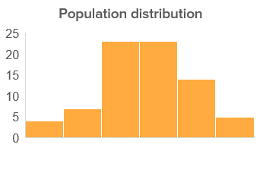
Sample vs. Population
Sample statistics
Sample mean (µ)
Sample Standard deviation (sigma)
Probability Distributions
Normal Distribution (Compare vs. Standard Normal)
Discrete probability distribution
Create using python (scipy.stats examples)
Random Sampling method
Expected value explanation
Business examples of data agencies to consolidate worldwide data
Notes:
For learners with more coding background, they find this area difficult and need to understand the probability distributions well.
Moreover data agencies, be it consumer or scan data research, adopt these principles.

Slide 7
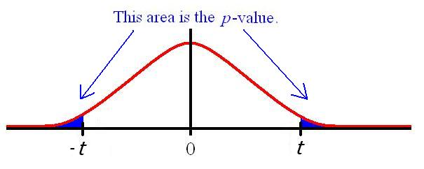
Converting Business Hypothesis to Statistical Test
Understanding
Diagnosis
Hypothesis
Evaluation
Prototype
Output
Hypothesis enables further analysis process and root causes of investigation.
E.g. (Business problem examples)
Most Customers in my target segment are in the age group of 31- 50
30% of patients tested for cancer are detected to be positive.
Task: What is the Null/alternate hypothesis for above examples?
Null vs. Alternate Hypothesis (Loan default example)
Tip: Best way to identify null/ alternate
(Status Quo vs. challenging statement)
p- value: Level of Significance
Accept / reject null using critical regions
Notes:
This is where tech background learners are most confused hence explanations need to be detailed.

Slide 8
Central Limit Theorem
Infer population behaviour using sample data
Sample mean (µ)
Sample Standard error (sigma/ √n) where n = count of observations
Confidence interval (Range for margin of error)
Chosen level of significance
Z-score as per significance level represents acceptable levels of deviation from mean
Prediction using the Confidence intervals:
Wider range ensures higher tolerance, but precision is lowered.
95% confidence is preferred in most business cases.
Business example:
Estimation of expected consumers for new products as per survey
Expected inventory planning using tolerance levels.
Notes:
Showing them calculation will help understand the concept.
Those with economics or statistics background will gain from real life business examples

Slide 9
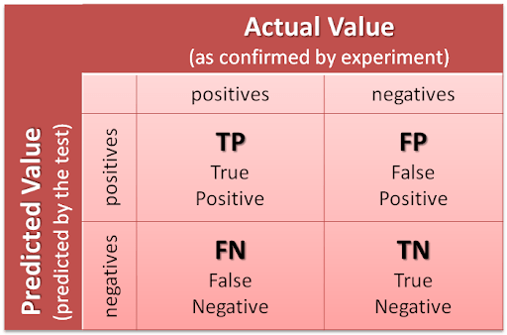
Type 1 and Type 2 Errors
Alpha: False Positives, Beta: False negatives
Tradeoff: Precision vs. Accuracy
Depends on Industry & business problem
(e.g. Cancer detection, Loan Default)
What do you expect?
Increase detection power (Sensitivity)
Reduce failure in prediction (Specificity)
Where:
Positives are true alternate hypothesis
Negatives are true null hypothesis

Slide 10
Focussed teaching: Let’s Code Together
Coding Time

Slide 11
Focussed teaching: Quiz Time
Quiz Time
Notes:
https://forms.gle/stdN9qpQzTjfUtAJ6

Slide 12
Focussed teaching: Solve a Problem
Problem: An examiner create an objective exam with four options in it. A, B, C, and D? with Equal probability. i.e. 25% each. You have observed the 100 test samples
We have
Null hypothesis: All probabilities are equal
Alternative hypothesis: All probabilities are not equal.
Now using the Chi-Square hypothesis reject or fail to reject null hypothesis.
(significance level = 0.05)
Option | Expected | Observed
A | 25 | 20
B | 25 | 20
C | 25 | 25
D | 25 | 35

Slide 13

Doubt resolution
Questions??

